Slide 1
MID-YEAR PRESENTATION by
KWADWO KARIKARI DUKU

Slide 2
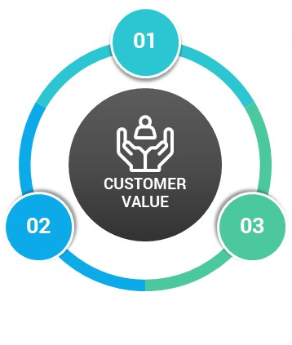
PRESENTATION OUTLINE
CLASSROOM INDUCTION
PRESENTATION OUTLINE
ON-SITE OPERATIONS
RECOMMENDATION & CONCLUSION

Slide 3


COMPANY PROFILE
VISION
MISSION
VIVO ENERGY GHANA
VALUES
To be the leading and most respected energy business in Africa.
To safely provide innovative and responsible energy solutions to Africa, which enable growth and development of the continent and its people.
  Exclusive marketer and distributer of Shell-branded products and services
Honesty
Integrity
Respect for people
3%

Slide 4
HOW VEGH OPERATES
CONVENIENT RETAIL
RETAIL
Deals with the sale of Shell branded fuel and/or lubricants to motor vehicles at the filling station.
Filling stations are grouped into 14 territories/zones.
Deals with all Non-fuel retail at Shell filling stations.
Shell shops, Lube bay, ATM, Pharmacy, Food services, Laundry, Car wash, etc.
SUPPLY & DISTRIBUTION
Deals with the supply of shell fuels and/or Lubricants to customers.
Fuel supply, Lube supply, Aviation, Logistics, Engineering, Depot operations & Product quality
MARKETING
Support the sale of Shell fuels and lubricants by projecting the Shell brand/products to consumers.
COMMERCIAL/B2B
Deals with the sale of bulk fuel and/or lubricants to other business groups like Mining, Aviation, Manufacturing, Transport/Power, Construction Industries, etc.
Shell card.
HSSE
Ensures that all activities of VEGH are done in a safely and environmentally friendly manner or procedure.
Notes:
© Copyright PresentationGo.com – The free PowerPoint template library

Slide 5
HOW VEGH OPERATES
B2C
CUSTOMER SERVICE
Deals with the sale of only Shell lubricants to Distributers, Exporters, Marine vessels and Franchise Workshops.
Serves as a frontline or an intermediary between VEGH and its customers.
Call Management, Order placement, product diversions, etc.
LEGAL
COMMUNICATION
Averts all possible risks that VEGH is likely to face..
Deals with all legal issues in the company.
Facilitates information within and outside the organization.
Deals with stakeholder engagements and the projection of all VEGH activities to the media.
FINANCE
HUMAN RESOURCE
Supports the business with financial plans.
Records all business transactions.
Planning and Budgeting
Manages the Human resource in VEGH.
Provides strategic planning for staffing, conducting interviews, and hiring personnel to foster a productive work atmosphere.
Notes:
© Copyright PresentationGo.com – The free PowerPoint template library

Slide 6
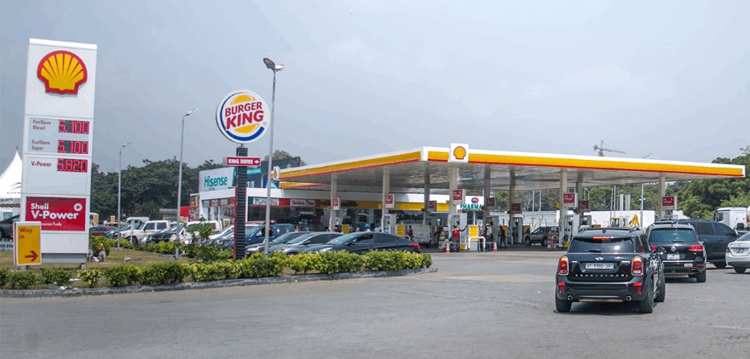
ON SITE OPERATIONS
Fuel
FuelSave Super,
FuelSave Diesel,
Shell V-Power
Lubricants
Other Non Fuel Retail
ATM/ Quick Cash
Food services
Forecourt Top up
Lube bay services
Payment system – Cash, Shell card and EzyPass Card
Shop
Car wash
Helix, Rimula, Advance
Notes:
© Copyright PresentationGO.com – The free PowerPoint and Google Slides template library

Slide 7
ON SITE OPERATIONS
Sites are managed by Site managers and/or QHMs.
RFC, GEA, VOC.
Records keeping.
Regulatory authorities;
NPA
EPA
GSA.
Site maintenance procedures
Role of VEGH and Retailers in maintenance issues.
Role of contractors.
Customers Champions are educated on all Safety measures.
Customer Champion app.
9 – point of customer Service.
LFI.
Money Handling.
Lubebay management.
Management of ONFR (Shops, Car wash, Pharmacy, Food services, Laundry, etc.)
Opening and closing dips.
Wet stock management.
Daily lubes check on MDU.
Opening and closing of meter sales reading.
Notes:
© Copyright PresentationGO.com – The free PowerPoint and Google Slides template library

Slide 8







SHELL PRODUCTS
Fuelsave Diesel Fuelsave Unleaded V-Power
Base fuel/fluid
Additive
Shell Lubricant

Slide 9

RECOMMENDATION
Liasing with the Legal department to draft a new format of contract for the CODO Retailers.
Providing a tolerance level during Credit Vetting for Retailers with a valid financial security but with an uncompleted Contract.
Increasing the number of Banks where customers can get Shell cards instantly.
Increasing the Credit days to about 10 days maximum.
Notes:
© Copyright PresentationGO.com – The free PowerPoint and Google Slides template library

Slide 10
CONCLUSION
Notes:
© Copyright PresentationGO.com – The free PowerPoint and Google Slides template library

Slide 11
THANK YOU

